Slide 1
Analyse International Debt Statistics
(Wireframe Documentation)

Slide 2
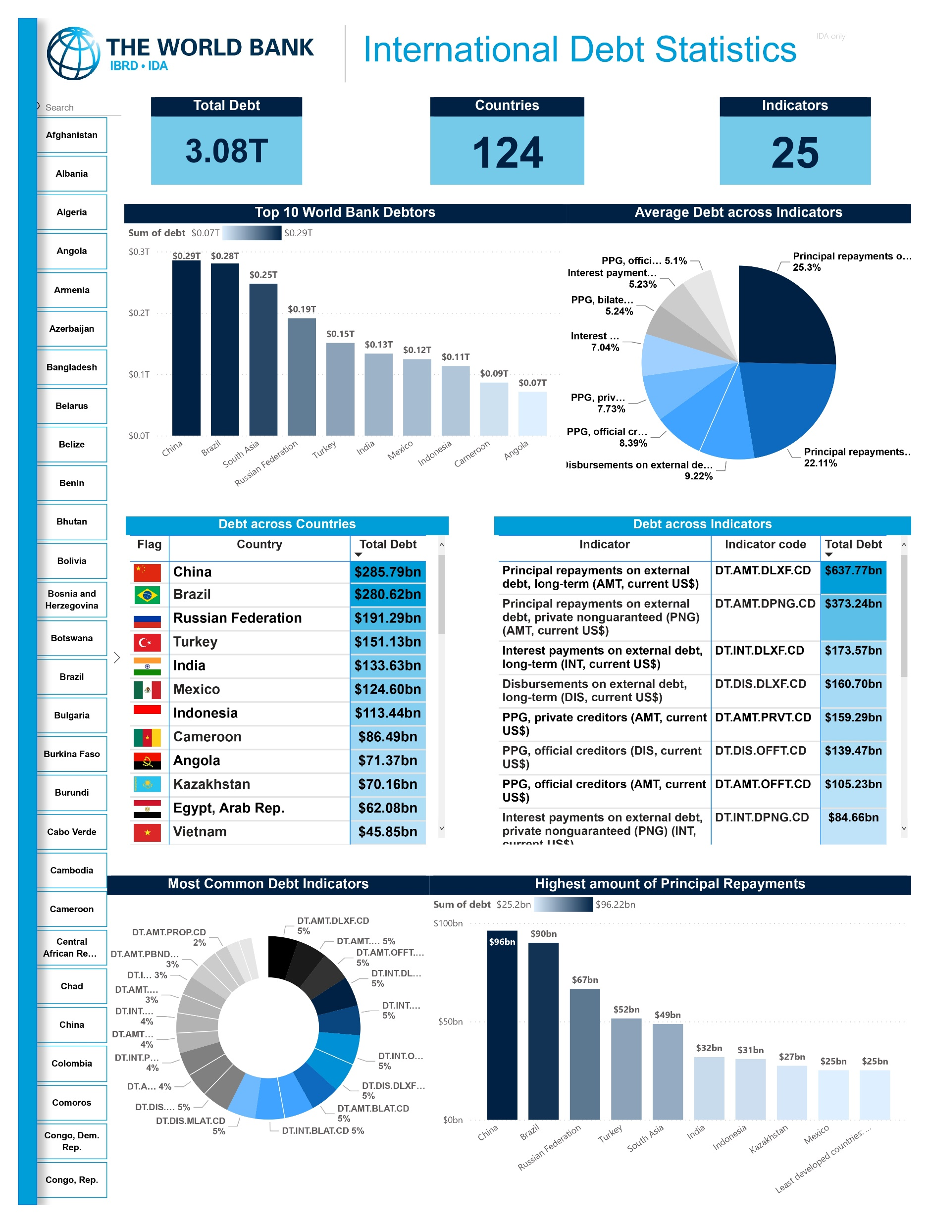

Slide 3
Insights:
Indicator Code DT.AMT.DLXF.CD has the maximum sum of debt worth $707.0 bn (USD) and the maximum number of owed countries ranging up to 123.
China is the one of the countries counting highest number of debts worth $ 285.8bn (USD) leading by country Brazil owing $ 281bn (USD). Summing over $ 566.4 bn (USD).
Indicator Code DT.AMT.DLXF.CD and DT.AMT.DPNG.CD are the highest amount of average debt indicator counting to 203 times.
China and Brazil both are the owed with these indicators and with the highest amount of principal repayment.

